Slide 1
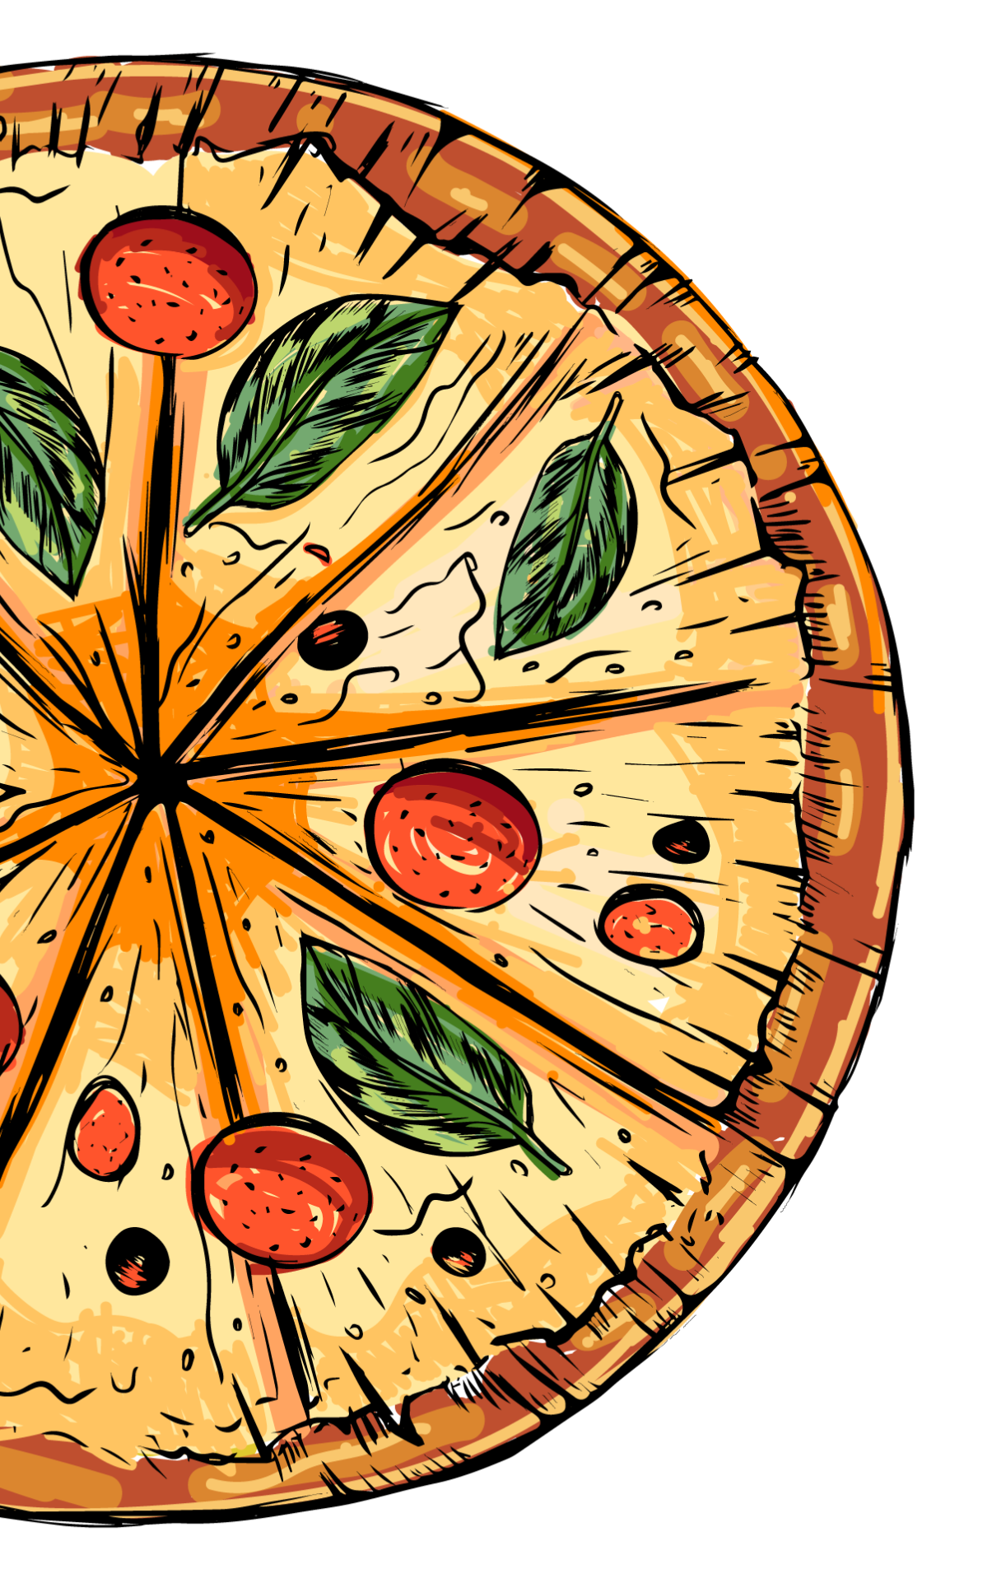

PIZZA SALES
www.slidesgo.es
ANALYSIS
Malleshwari Bhimanpalli

Slide 2
TABLE OF CONTENTS
01
02
03
04
INTRODUCTION
CONCEPT & TOPIC
OBJECTIVES
PROBLEM STATEMENT
05
DASHBOARD

Slide 3
INTRODUCTION
The Pizza dataset contain detailed information about pizza orders, including specifics about the pizza variants, quantities, pricing, dates, times, and categorization details.

Slide 4
PIZZA CONCEPTS
Pizza sales analysis evaluates order quantity, price, category, and names across various stages—monthly and daily—to identify key revenue, sales, and quantity factors. This enables pinpointing highest and lowest sales periods, facilitating targeted menu adjustments, pricing strategies, and promotional activities for optimized profitability and customer engagement.

Slide 5
WHAT IS THIS TOPIC ABOUT?
KPI’s
Customer Preferences
Revenue, Order Value, Quantity, etc
Pizza Category, Name, Size, etc
Sales Pattern
Monthly Trend, Category, Pizza Size, etc

Slide 6
OBJECTIVES
Utilized SQL and Power BI to analyze one year of pizza sales data, extracting valuable insights for informed decision-making. The project aimed to identify key trends, customer preferences, and sales patterns, providing a foundation for optimizing inventory, and operational efficiency to drive future growth and profitability.

Slide 7

PROBLEM STATEMENT
We need to analyze key indicators (KPI’s) for our Pizza sales data to gain insights into our business performance such as:
Total revenue over the year
Average order value
Total pizzas sold
Total Orders
Average Pizzas per order
Apart from this, we need to analyze the data in respect of sellers, trends, most profitable category, preferrable sizes by the customers, total quantity sold over the year.

Slide 8
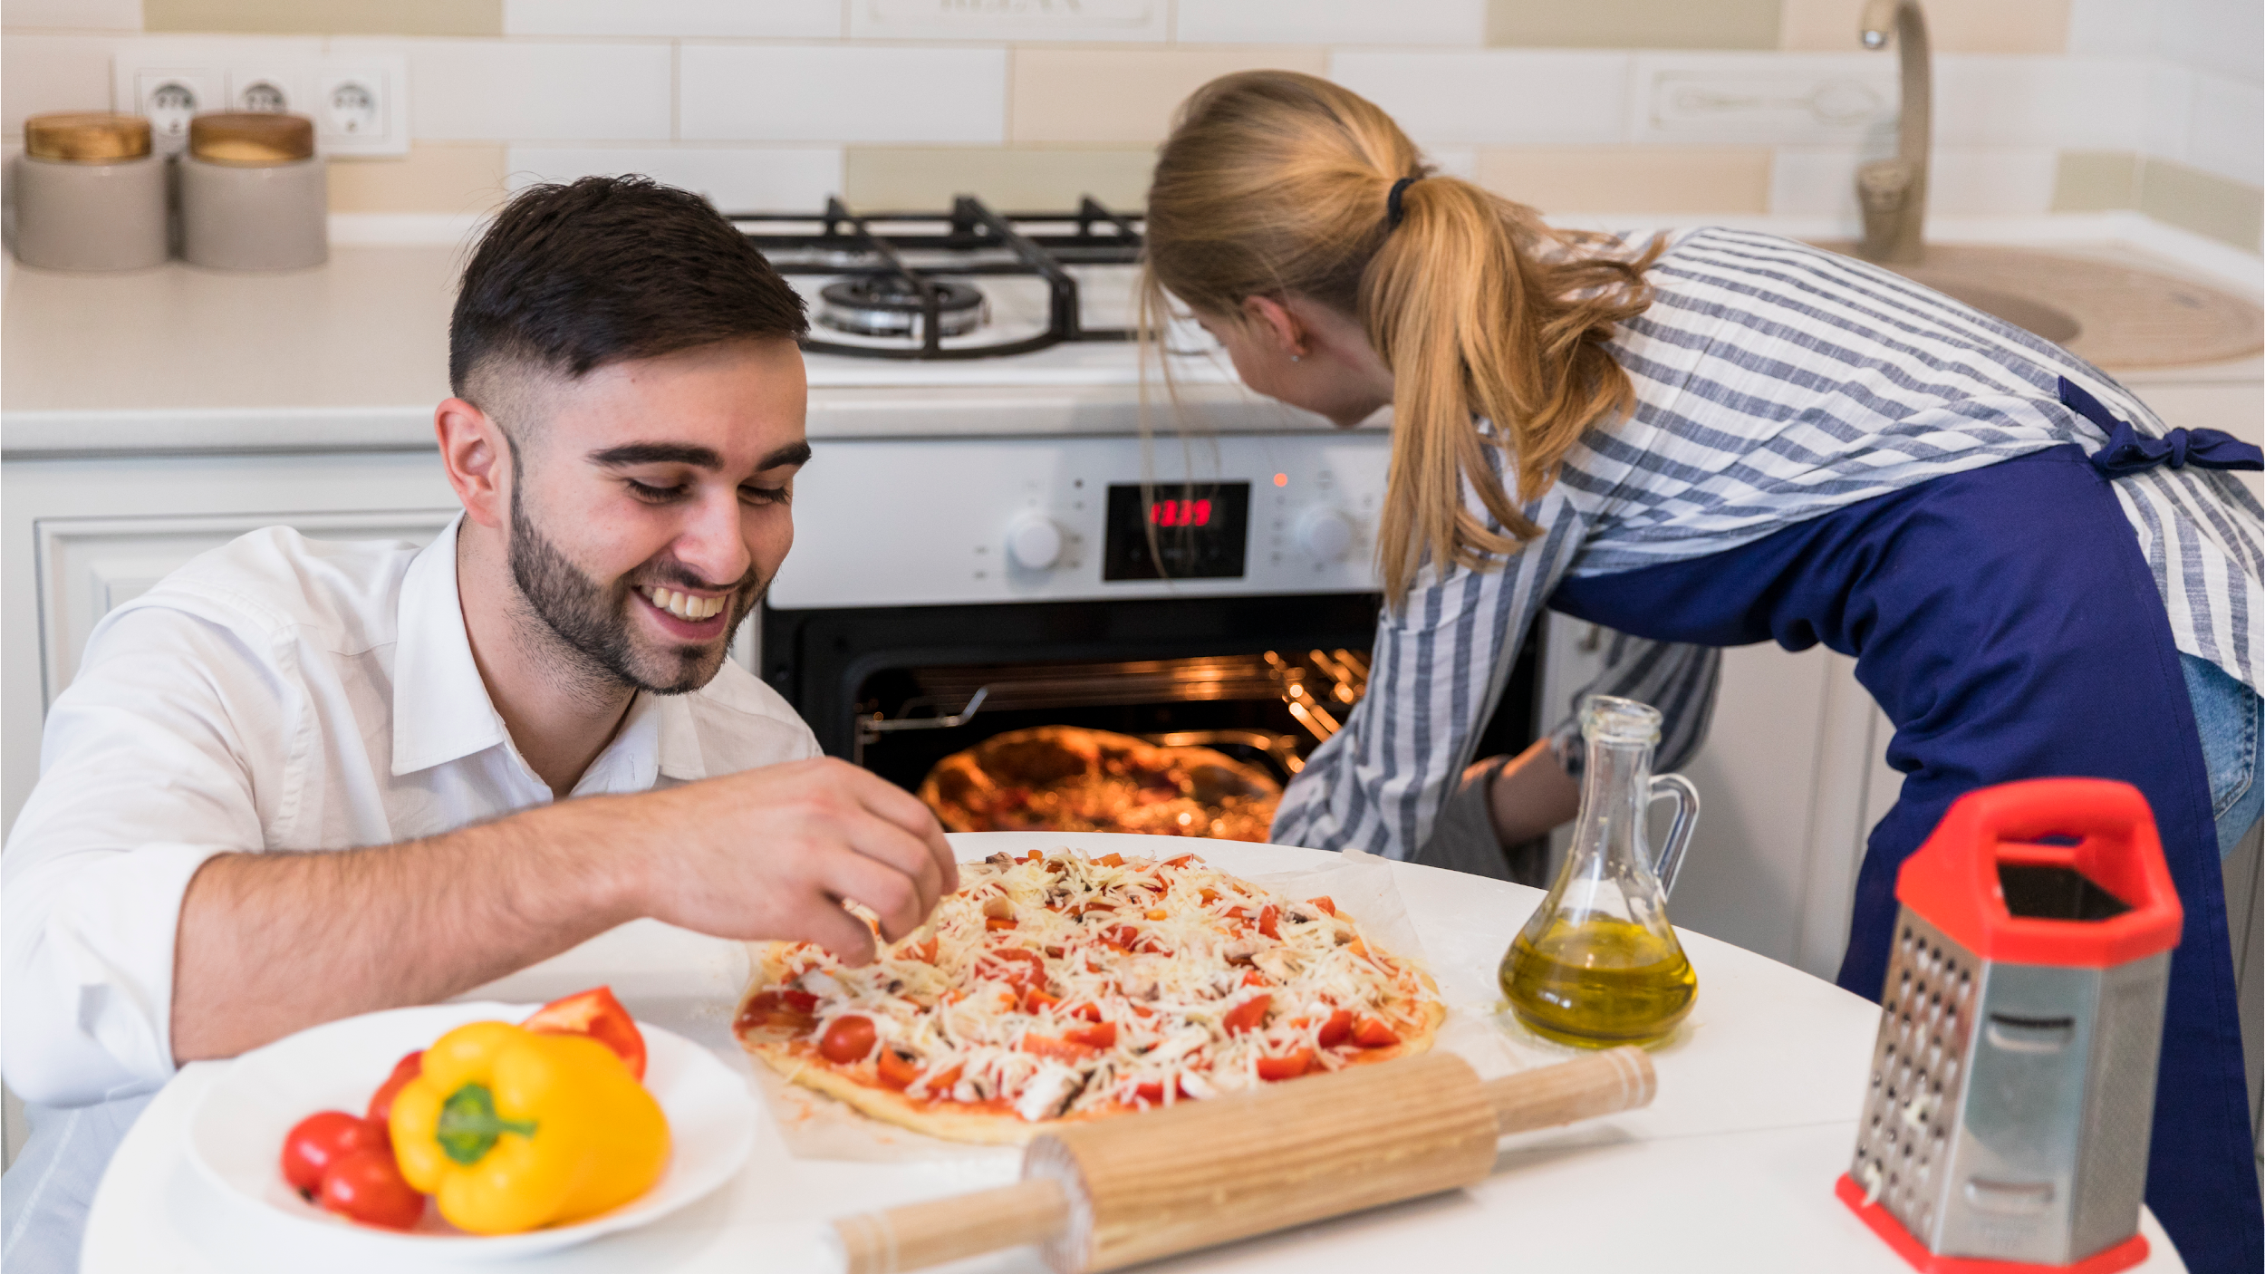


Slide 9
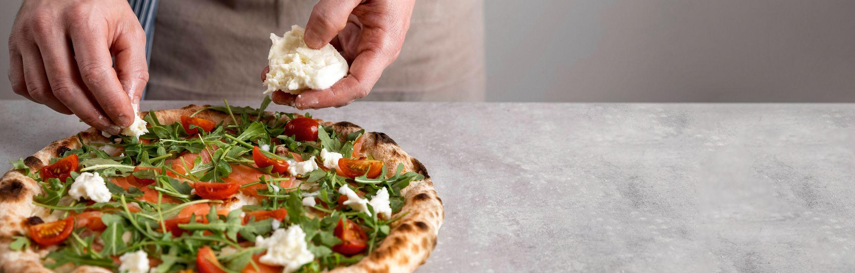
SUMMERY
Pizza sales analysis reveals trends and customer preferences, guiding menu optimization, pricing, and promotions. It helps businesses grow by enhancing profitability, improving customer satisfaction, and informing strategic decisions.

Slide 10
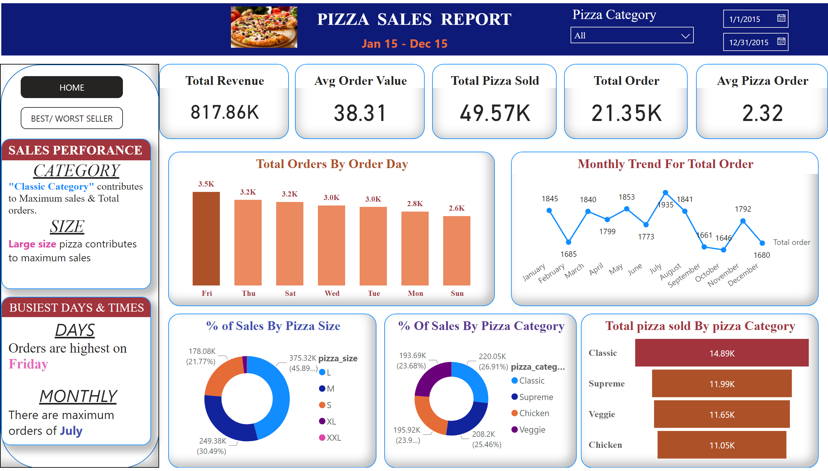
DASHBOARD

Slide 11
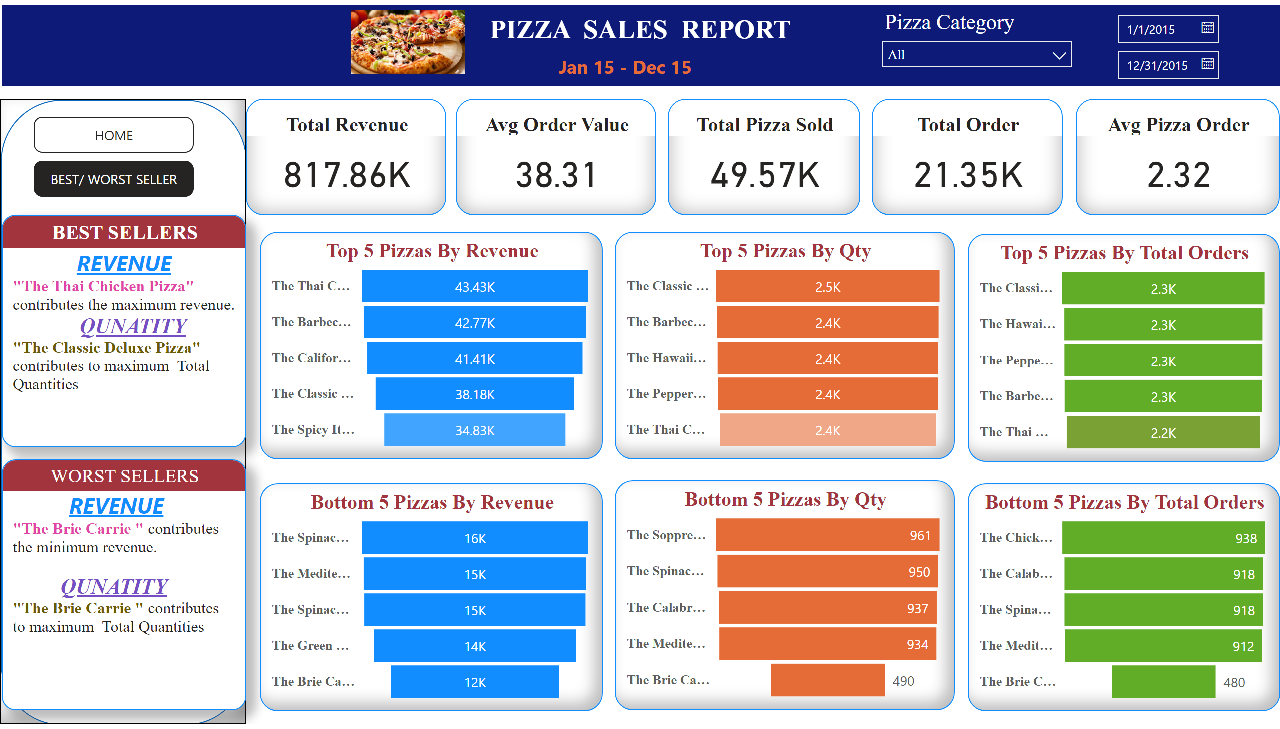
DASHBOARD

Slide 12



THANKS!

